Slide 1
February 3rd Sprint Presentation
Capstone Defense

Slide 2
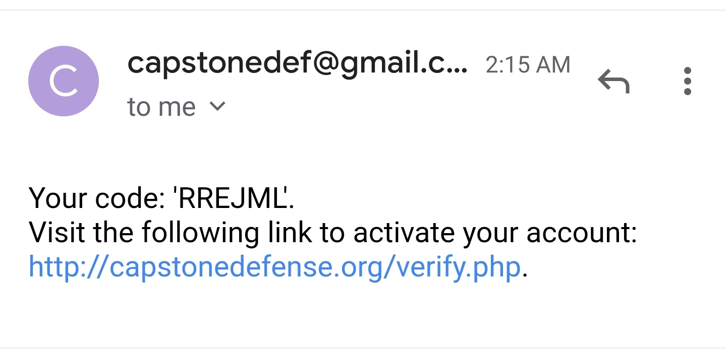
Left overs from Sprint 1
Fixing email verification
Added link to verify email
Added unique hash to email for verification
Separated role field from lock field

Slide 3
User Stories (Sprint 2)
As a gamer, I want to play the game without distractions.
As a gamer, I want to be able to move my character using movement controls.
As a gamer, I want to check my personal high score in the game.
As a gamer, I want to be able to view the leaderboard for all the high scores.
As a gamer, I want to be able to change my username after creating the account.
As a gamer, I want to be able to change my password anytime.
As a gamer, I want to set a limit on how long I want to play the game.
As a gamer, I want to be reminded to take a break when I’ve been playing for too long.
As a gamer, I want to be able to log into my account using Google authentication.

Slide 4
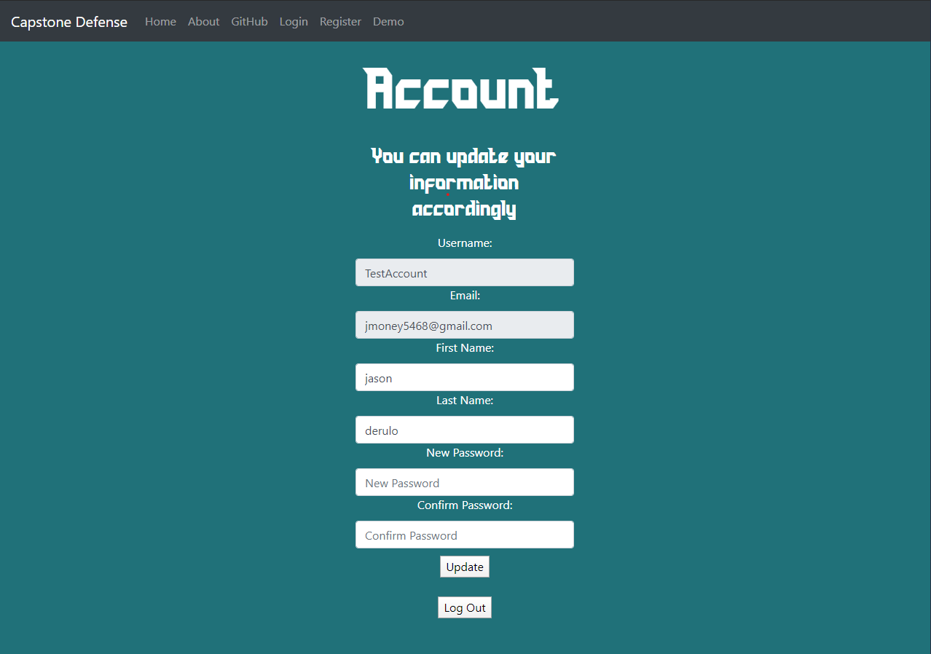
Profile Updating
A user is able to update their first name, last name, and password
Email is an important field which we believe shouldn’t be modifiable
Username is debatable because some users wish to change username for high score table

Slide 5
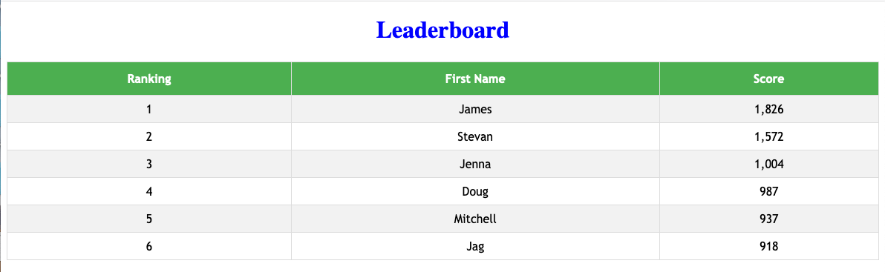
Leaderboard
Leaderboard will be ordered from highest score to lowest
Next sprint: calculate scores for full functionality

Slide 6
Movement Controls
Focused on Mobile Movement Controls first
Added left and right joysticks
Plans
Left Joystick is movement and rotation of camera
Right Joystick is construction wheel for towers
Possibly adding abilities with the ability to switch between on a click of the right joystick
This is our top priority to polish

Slide 7
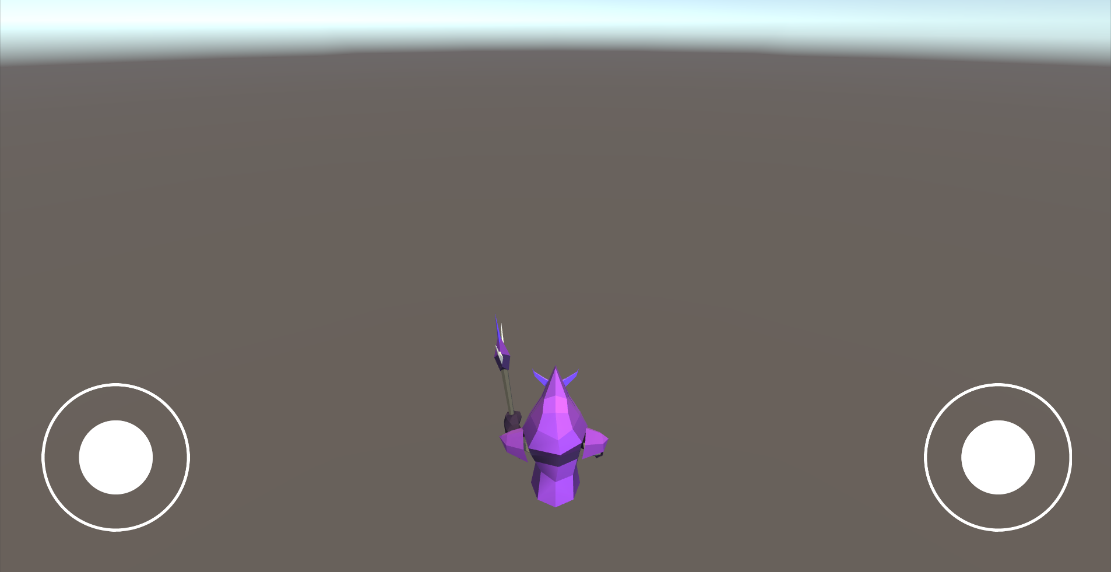

Slide 8
“Take a break” Reminder
Ethical concerns
We do not know how long players plan on playing but we want the reminder for people to take a break from gaming

Slide 9
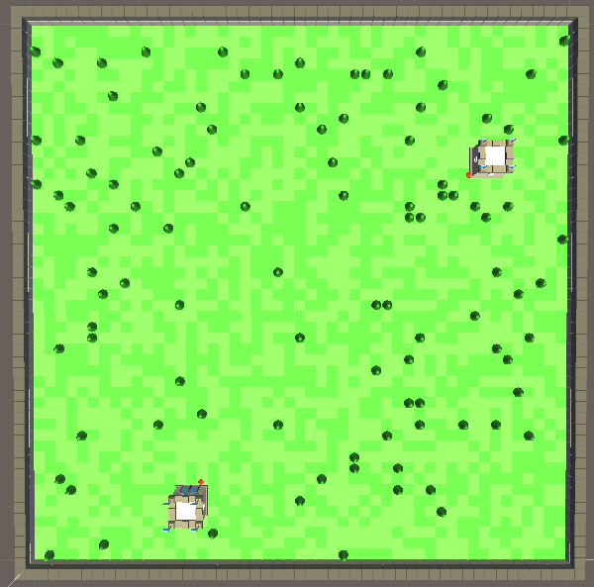
Level Generation
Each level is dynamically created
Each zone is set to 100x100
1 block wall keeping everything in
In the upcoming sprints
Different assets and color pallets can be generated when you start the level
More cohesive levels

Slide 10
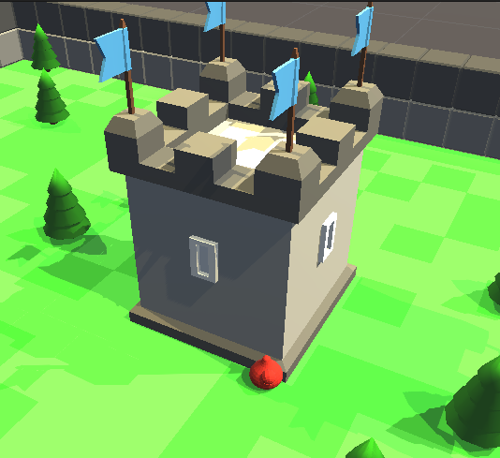
Enemy Generation
Two Types of enemies can spawn
Spawn points are currently set to castle’s that spawn
It is possible for a map to spawn without castles
Enemy AI is currently at its “Easiest” difficulty

Slide 11
QA Testing for Sprint 2
Navigation bars still not visible on iOS or Android devices
New web pages function the same as the original pages from last sprint.
In order to implement Google authentication, we had to temporarily break standard username/password login
Hope to resolve this next sprint
Design issues
Inserting hyperlinks where appropriate, especially on the main page
Early testing of controls are working as intended.
Profile updating testing will be conducted once new authentication has been fully implemented and tested.
All testing on the game was done within the editor for this sprint, for future sprints testing will be conducted through the intended platforms.

Slide 12
Demo

